Slide 1
Cloud Computing and Cloud Networking
K. K. Ramakrishnan
kk@cs.ucr.edu
CS 208, Winter 2025
Tue-Thur 2 pm - 3:20 pm
Class 2, 3

Slide 2
Virtualization in Operating Systems
Class 2

Slide 3
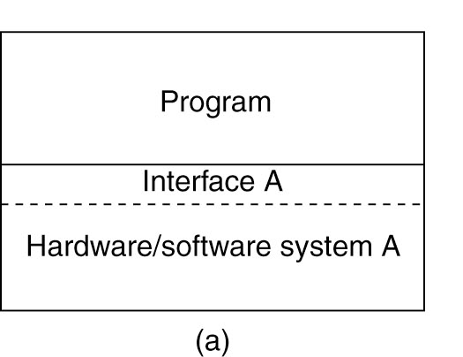
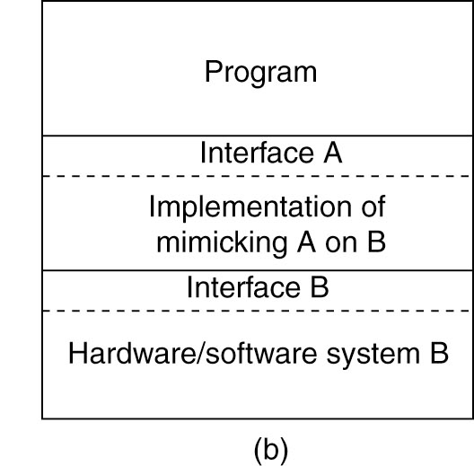
Virtualization
Virtualization: extend or replace an existing interface to mimic the behavior of another system.
Introduced in 1970s: run legacy software on newer mainframe hardware
Handle platform diversity by running apps in VMs
Portability and flexibility
Thanks to Prof. Prashant Shenoy, CS Umass
for many of the slides here

Slide 4
Papers to Read
M. Rosenblum, T. Garfinkel, Virtual machine monitors: current technology and future trends, IEEE Computer, 38:5, May 2005.
Paul Barham, Boris Dragovic, Keir Fraser, Steven Hand, Tim Harris, Alex Ho, Rolf Neugebauer, Ian Pratt, and Andrew Warfield, Xen and the art of Virtualization, Proc. of SOSP, October 2003

Slide 5
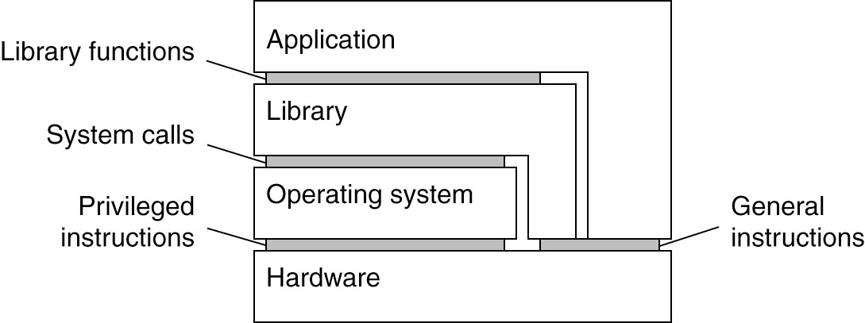
Types of Interfaces
Different types of interfaces
Assembly instructions
System calls
APIs
Depending on what is replaced /mimic-ed, we obtain different forms of virtualization

Slide 6
Types of Virtualization
Applications
Applications
Applications
Guest OS
Non-
privileged
mode
Application
Guest OS
VMM
VMM
OS
Host OS
VMM
VMM (Hypervisor)
Host
OS
Privileged
mode
Hardware
Hardware
Hardware
Hardware
Physical
machine
Hosted VM
Native VM
Dual-Mode VM
Virtual machines can be built in multiple ways
1) With a VMM on top of the bare-metal: so hypervisor is in privileged mode, and mediates access to CPU, disk etc.
2) VMM runs on top of Host OS.
3) VMM implemented in dual mode: Part of VMM in user mode, part in kernel (OS needs modifications).

Slide 7
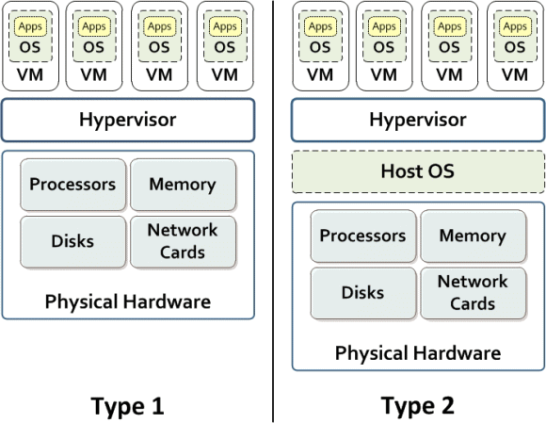
Two broad types of hypervisors
Type 1: Native (bare metal) - – example of Full/Native Virtualization
Hypervisor runs on top of the bare metal machine
e.g., VMWare Workstation
Type 2: Hosted Virtual Machines
Hypervisor is an emulator
e.g., KVM, QEMU
Notes:
Figure credit: IBM

Slide 8
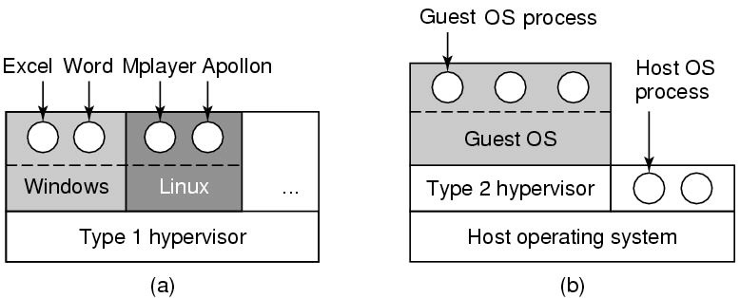
Types of Hypervisors
Type 1: hypervisor runs on “bare metal”
Type 2: hypervisor runs on a host OS (like hosted VMs)
Guest OS runs inside hypervisor
Both VM types act like real hardware from application standpoint

Slide 9
Types of Virtualization
Full/native Virtualization (Type 1)
VM simulates “enough” hardware to allow an unmodified guest OS to be run in isolation (isolation from one VM to another is an important characteristic for users sharing a cloud platform)
Same hardware CPU
IBM VM family, VMWare Workstation, Parallels, VirtualBox
Emulation (Type 2)
VMM emulates/simulates complete hardware
Unmodified guest OS for a different 'PC' can be run
Bochs, VirtualPC for Mac, QEMU

Slide 10
Protection through Isolation
Excerpted from Johanna Ullrich, Edgar R. Weippl, in “The Cloud Security Ecosystem”, 2015 (Elsevier)
Hypervisor provides efficient, isolated ‘duplicate’ of physical machine for VMs.
All sensitive instructions, (those changing resource availability or configuration), must be privileged instructions, to build effective hypervisor (Popek & Goldberg, ‘74)
all sensitive instructions cross (go through) the hypervisor, which is able to control VMs appropriately.
This is full virtualization: advantage is host OS does not have to be adapted, i.e., it is unaware of its virtualized environment.
But, often need # additional actions to be virtualizable, ➔ paravirtualization, binary translation & hardware-assisted virtualization

Slide 11
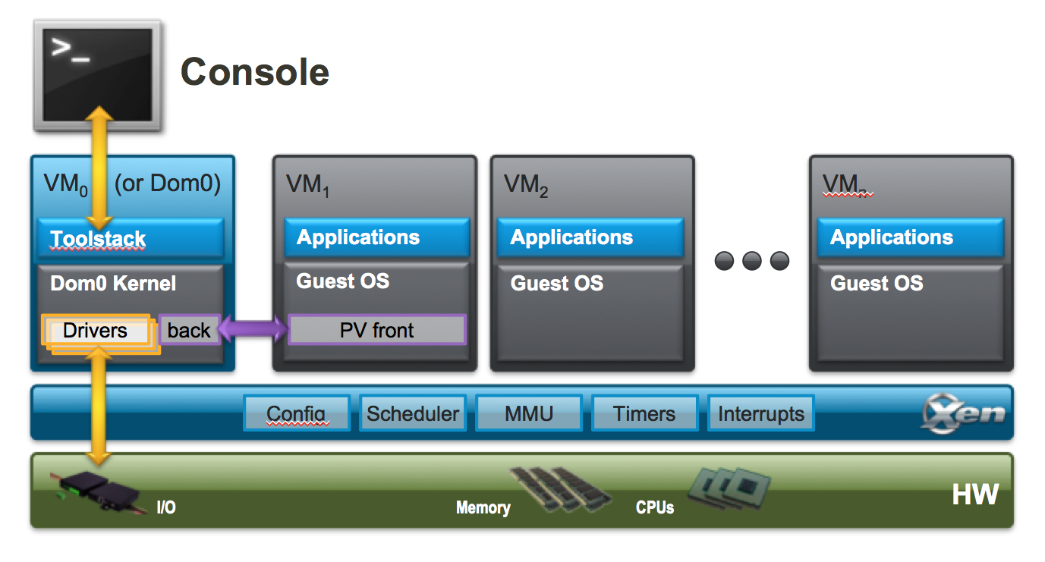
Hybrid organizations
User space
VMM
Hybrid hypervisors are popular: e.g., Xen
Mostly bare metal virtualization.
But, VM0/Dom0 to keep device drivers out of VMM
Paravirtualization (PV) front-end talks to Dom0

Slide 12
More on Types of virtualization
Para-virtualization
VMM does not simulate all of the hardware capabilities
Use special API that a modified guest OS must use
Hypercalls trapped by the Hypervisor and serviced through Dom0
Xen, VMWare ESX Server
OS-level virtualization
OS allows multiple 'secure' virtual servers to be run
Guest OS is the same as the host OS, but appears isolated
apps see an isolated OS
Solaris Containers, BSD Jails, Linux Vserver, Linux containers, Docker
Application level virtualization
Application is given its own copy of components that are not shared
(E.g., own registry files, global objects) - VE prevents conflicts
JVM, Rosetta on Mac (also emulation), WINE

Slide 13
Paravirtualization
Paravirtualization: changes to the system in order to redirect privileged sensitive, instructions over to the hypervisor to regain full control on the resources
Redirect rather than ‘trap’
Privileged instructions: storage protection setting, interrupt handling, timer control, I/O, special processor status-setting instructions - executed only in special privileged mode for OS but not user program
Guest OS modified to work with hypervisor. OS is aware that it is virtualized.
Apps that run on top of altered OS - no change required
OS mods require work; but performance improves
See: Crosby & Brown, ACM Queue 2006 (https://dl.acm.org/doi/pdf/10.1145/1189276.1189289)
Paravirtualization, generally able to run on any system

Slide 14
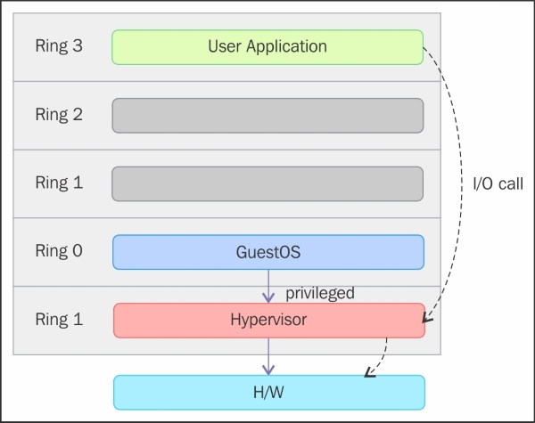
A note on Operating System Rings
On most OSs, Ring 0 is level with most privileges and interacts most directly with physical hardware - CPU and memory.
Special gates between rings are provided to allow an outer ring to access an inner ring's resources in a predefined manner, as opposed to allowing arbitrary usage.
Linux x86 ring usage: Linux kernel only uses 0 and 3:
0 for kernel – can do anything
3 for users
ring 3 cannot run several instructions and write to several registers
Ring 0
Focus only on
Ring3: user space
Ring0: kernel,
Can run privileged instructions

Slide 15
How does Virtualization work?
CPU supports kernel and user mode (ring0, ring3)
There is a set of instructions that can only be executed in kernel mode
I/O, change MMU settings etc -- sensitive instructions
Privileged instructions: cause a trap when executed in user mode
Result: type 1 virtualization is feasible if sensitive instruction subset are handled by the VMM, since it runs in Privileged mode
Intel 386: ignores sensitive instructions in user mode
Recent (well – ‘old’ now) Intel/AMD CPUs have hardware support
Intel VT, AMD SVM
Intel® Virtualization Technology provides hardware assist to the virtualization software, reducing its size, cost, and complexity.
Create an environment where a VM and guest OS can run
Hypervisor uses hardware bitmap to specify which inst. should trap
So, Sensitive instruction in guest traps to hypervisor

Slide 16
Hardware Assisted Virtualization
Hardware-assisted virtualization: achieved by additional functionality included into CPU,
specifically an additional execution mode called guest mode, dedicated to virtual instances
Requires specific hardware
Intel & AMD - realized full virtualization & paravirtualization were major challenges and created new processor extensions: VT-x & AMD-V
virtualization-aware hardware provides the support to build the VMM and also ensures isolation of a guest OS.
representative of this virtualization type is the Kernel-based Virtual Machine (KVM)

Slide 17
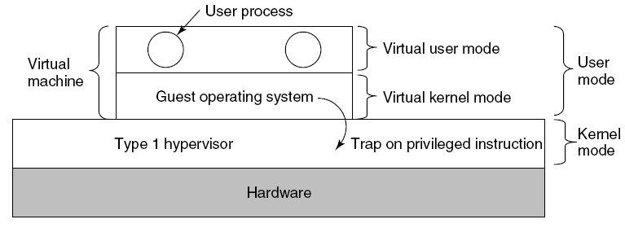
Type 1 hypervisor
Unmodified OS is running in user mode
But it thinks it is running in kernel mode (virtual kernel mode)
privileged instructions trap; sensitive inst-> use VT to trap
Hypervisor is the “real kernel”
Upon trap, executes privileged operations
emulates what the hardware would do

Slide 18
Binary Translation
What did we do before hardware assist was available?
VMware example
Upon loading program: scans code for basic blocks
(basic block: straight-line code sequence with no branches)
If sensitive instructions, replace by VMware procedure
Binary translation
Conversion can be expensive: Cache the modified basic block in VMware cache for subsequent reuse
Execute; load next basic block etc.

Slide 19
Type 2 Hypervisor
Applications
Hosted VM
VMM
Host OS
Hardware
Type 2 hypervisors can work without virtualization technology (VT) support
Host OS responsible for executing privileged instructions and is running in kernel mode (with privileges)

Slide 20
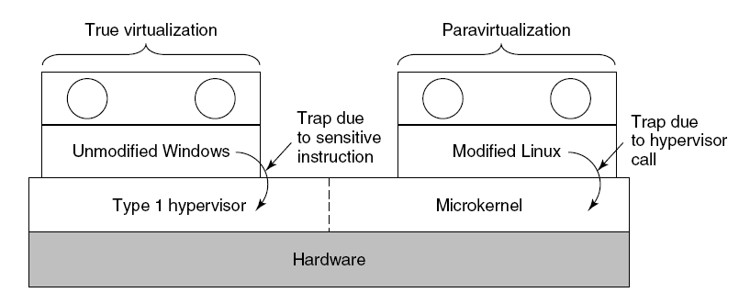
True VMs vs. Paravirtualization
User
space
Redirect/hypercall
Both type 1 and 2 hypervisors work on unmodified OS
Paravirtualization: modify OS kernel to replace all sensitive instructions with hypercalls
OS behaves like a user program making system calls
Hypervisor executes the privileged operation invoked by hypercall.

Slide 21
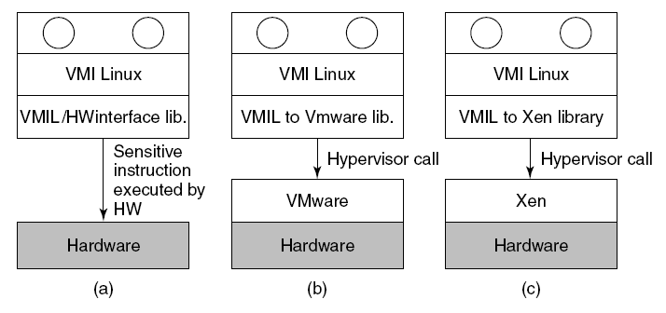
Standard Virtual machine Interface
Type 1
Standardize the VM interface (VMIL) so kernel can run on bare hardware or any hypervisor
Can help a VM run on bare hardware (like a Type 1)
Allows for VMs using binary translation (like a Type 2) – as if the VMWare is the OS after translation is performed
Allows for VMs to run on Xen (Paravirtualization)

Slide 22
Memory virtualization
OS manages page tables
Creating a new pagetable is sensitive priv. operation -> traps to hypervisor
Hypervisor manages multiple OSs
Need a second shadow page table – perform two level mapping:
A typical OS translates VM virtual pages to VM’s physical pages
Hypervisor maps to actual page in shadow page table
Need to catch changes to page table (but that is not a privileged instruction)
Change Page Table to read-only - page fault on update
Paravirtualized system - use hypercalls to inform changes to page table

Slide 23
I/O Virtualization
Each guest OS thinks it “owns” the disk
Hypervisor creates “virtual disks”
Large empty files on the physical disk that appear as “disks” to the guest OS
Hypervisor converts block # to file offset for I/O
But DMA needs physical addresses
Hypervisor needs to do the translation to physical addresses

Slide 24
More Details on Virtualization Functionality
Slides from Prof. Nael Abu-Ghazaleh @UCR in his OS Course

Slide 25
NUTS and BOLTS

Slide 26
Full virtualization
Idea: run guest operating systems unmodified
However, hypervisor is the real privileged software
When OS executes privileged instruction, trap to hypervisor who executes it for the OS
This can be very expensive
Also, subject to quirks of the architecture
Example, x86 fails silently if some privileged instructions execute without privilege
E.g., popf

Slide 27
Example of Hypervisor Intervention: Disable Interrupts
Guest OS tries to disable interrupts
the instruction is trapped by the VMM which makes a note that interrupts are disabled for that VM
Interrupts arrive for that machine
Buffered at the VMM layer until the guest OS enables interrupts.
Other interrupts are directed to VMs that have not disabled them
This action can be expensive

Slide 28
Binary translation--making full virtualization practical
Use binary translation to modify OS to rewrite silent failure instructions
More aggressive translation can be used
Translate OS mode instructions to equivalent VMM instructions
Some operations still expensive
Cache for future use
Used by VMWare ESXi and Microsoft Virtual Server
Performance on x86 typically ~80-95% of native

Slide 29
Binary Translation Example
Guest OS Assembly
Translated Assembly
do_atomic_operation:
cli
mov eax, 1
xchg eax, [lock_addr]
test eax, eax
jnz spinlock
…
…
mov [lock_addr], 0
sti
ret
do_atomic_operation:
call [vmm_disable_interrupts]
mov eax, 1
xchg eax, [lock_addr]
test eax, eax
jnz spinlock
…
…
mov [lock_addr], 0
call [vmm_enable_interrupts]
ret
CLI: Clear Interrupt Flag; STI — Set Interrupt Flag

Slide 30
Paravirtualization
Modify the Guest OS to make it aware of the hypervisor
Can avoid these tricky features
OS is aware of the fact it is virtualized
Can implement optimizations
How does it Compare to binary translation?
Amount of code change?
1.36% of Linux, 0.04% for Windows

Slide 31
Hardware supported virtualization (Intel VT-x, AMD-V)
Hardware support for virtualization
Intel® Virtualization Technology hardware assist for virtualization
Makes implementing VMMs much simpler
Streamlines communication between VM and OS
Removes the need for paravirtualization/binary translation
EPT: Support for shadow page tables

Slide 32
Virtualization Tasks
Virtualize hardware
Memory hierarchy
CPUs
Devices
Implement data and control transfer between guests and hypervisor
We’ll cover this by example – Xen paper
Slides modified from presentation by Jianmin Chen

Slide 33
Xen
Design principles:
Unmodified applications: essential
Full-blown multi-task O/Ss: essential
Paravirtualization: necessary for performance and isolation
Paul Barham, Boris Dragovic, Keir Fraser, Steven Hand, Tim Harris, Alex Ho, Rolf Neugebauer, Ian Pratt, and Andrew Warfield, Xen and the art of Virtualization, Proc. of SOSP, October 2003

Slide 34
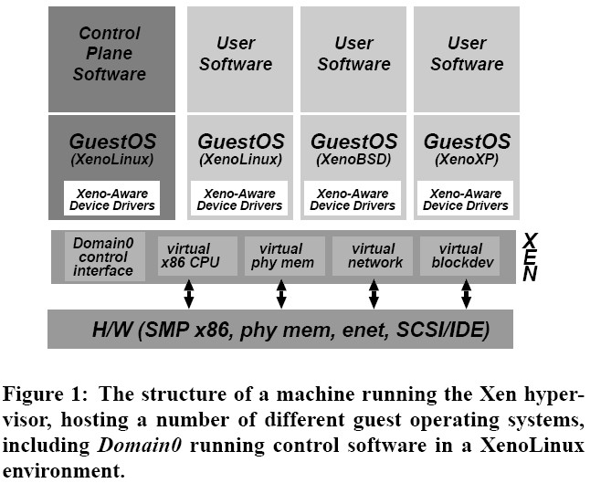
Xen
Domain 0

Slide 35
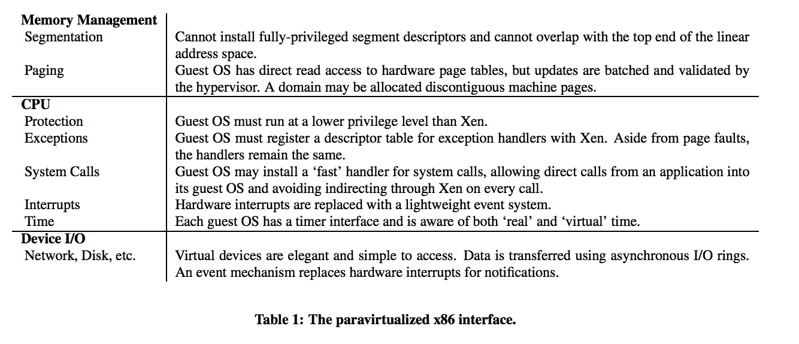
Implementation summary
Guest OS

Slide 36
Xen VM interface: Memory
Memory management
Guest cannot install highest privilege level segment descriptors; top end of linear address space is not accessible
Kernel direct mapping space
Guest has direct (not trapped) read access to hardware page tables; writes are trapped and handled by the VMM
Physical memory presented to guest is not necessarily contiguous
‘Guest’ ➔ Guest OS

Slide 37
Two Layers of Virtual Memory
Physical address → machine address
_{Host OS’s}
_{View of RAM}
Virtual address → physical address
_{0xFFFFFFFF}
_{Guest OS’s}
_{View of RAM}
_{Guest App’s}
_{View of RAM}
_{0xFFFF}
_{Page 2}
_{0xFF}
_{Page 0}
_{Page 0}
_{Page 3}
_{Page 2}
_{Page 1}
_{Page 1}
_{Page 3}
_{Page 0}
_{Page 3}
_{Page 1}
_{0x00}
_{Page 2}
_{Unknown to the guest OS}
_{Known to the guest OS}
_{0x0000}
_{0x00000000}

Slide 38
Guest’s Page Tables Are Invalid
Guest OS page tables map virtual page numbers (VPNs) to physical frame numbers (PFNs)
Problem: the guest is virtualized, doesn’t actually know the true PFNs (locations)
That true location is the machine frame number (MFN)
MFNs are known to the VMM and the host OS
Guest page tables cannot be installed in cr3
Map VPNs to PFNs, but the PFNs are incorrect
How can the MMU translate addresses used by the guest (VPNs) to MFNs?

Slide 39
Shadow Page Tables
Solution: VMM creates shadow page tables that map VPN → MFN (as opposed to VPN→PFN)
_{Guest Page Table}
_{Physical Memory}
VPN | PFN
00 (0) | 01 (1)
01 (1) | 10 (2)
10 (2) | 11 (3)
11 (3) | 00 (0)
₆₄
_{Maintained by the guest OS}
_{Invalid for the MMU}
_{Page 2}
3
₄₈
_{Page 1}
2
₃₂
_{Virtual Memory}
_{Page 0}
1
₁₆
₆₄
_{Page 3}
0
_{Page 3}
₀
₄₈
_{Page 2}
₃₂
_{Shadow Page Table}
_{Machine Memory}
_{Page 1}
₁₆
VPN | MFN
00 (0) | 10 (2)
01 (1) | 11 (3)
10 (2) | 00 (0)
11 (3) | 01 (1)
₆₄
_{Maintained by the VMM}
_{Valid for the MMU}
_{Page 0}
_{Page 1}
3
₀
₄₈
_{Page 0}
2
₃₂
1
_{Page 3}
₁₆
_{Page 2}
0
₀

Slide 40
Building Shadow Tables
Problem: how can the VMM maintain consistent shadow pages tables?
The guest OS may modify its page tables at any time
Modifying the tables is a simple memory write, not a privileged instruction
Thus, there are no helpful CPU exceptions to trap this action :(
Solution: mark the hardware pages containing the guest’s tables as read-only (guest page table)
If the guest updates a table, an exception is generated
VMM catches the exception, examines the faulting write, updates the shadow table

Slide 41
More VMM Tricks
The VMM can play tricks with virtual memory just like an OS can
Balooning:
The VMM can page parts of a guest, or even an entire guest, to disk
A guest can be written to disk and brought back online on a different machine!
Deduplication:
The VMM can share read-only pages between guests
Example: two guests both running Windows XP

Slide 42
Xen VM interface: CPU
CPU
Guest runs at lower privilege than VMM
Exception handlers must be registered with VMM
Fast system call handler can be serviced without trapping to VMM
Allow direct calls from application to Guest OS, rather than directing it through the VMM
Hardware interrupts replaced by lightweight event notification system
Timer interface: both for real and virtual time

Slide 43
Details: CPU
Frequent exceptions:
Software interrupts for system calls
Page faults
Allow “guest” to register a ‘fast’ exception handler for system calls that can be accessed directly by CPU in ring 1, without switching to ring-0/Xen
Handler is validated before installing in hardware exception table: To make sure nothing executed in Ring 0 privilege.
Not used for Page Fault

Slide 44
Xen VM interface: I/O
I/O
Virtual devices exposed as asynchronous I/O rings to guests
Event notification replaces interrupts

Slide 45
Details: I/O 1
Xen does not emulate hardware devices
Exposes device abstractions for simplicity and performance
I/O data transferred to/from guest via Xen using shared-memory buffers
Virtualized interrupts: light-weight event delivery mechanism from Xen-guest
Update a bitmap in shared memory
Optional call-back handlers registered by guest O/S

Slide 46
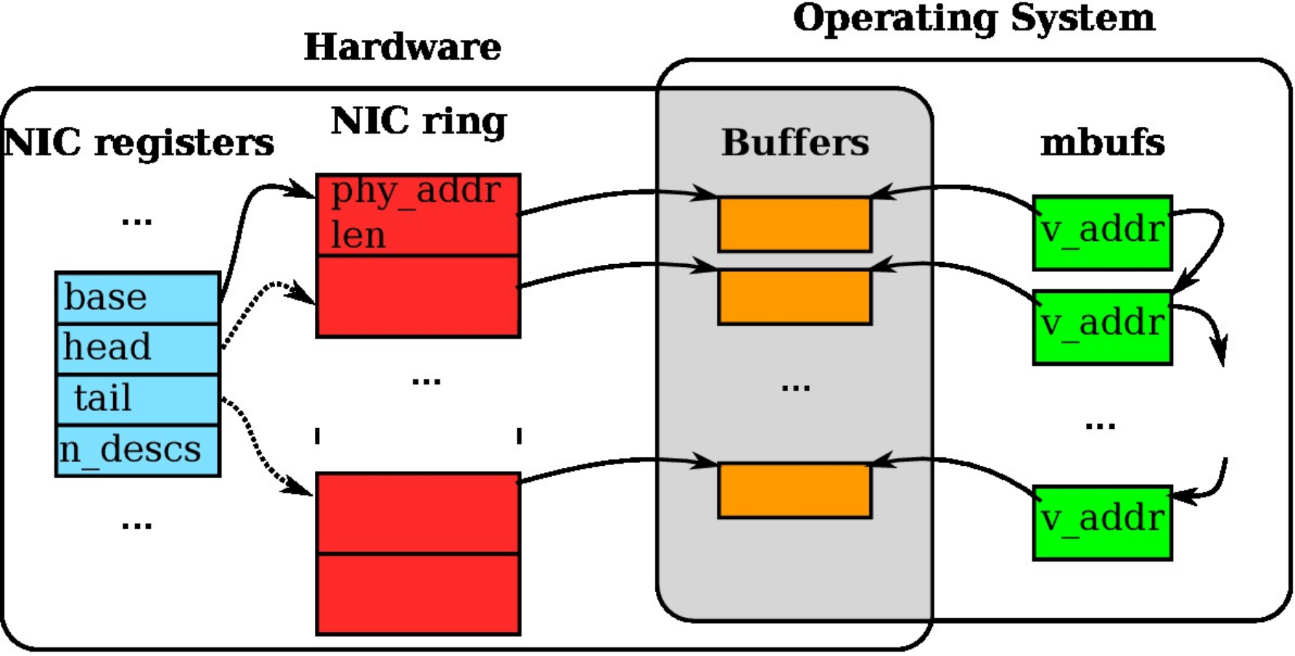
NIC data structure
NIC manages incoming and outgoing packets using circular queues (ring) of buffer descriptors
Each slot in the ring contains the length and physical address of the buffer
NIC registers (CPU accessible) indicate the portion of ring available for transmission and reception

Slide 47
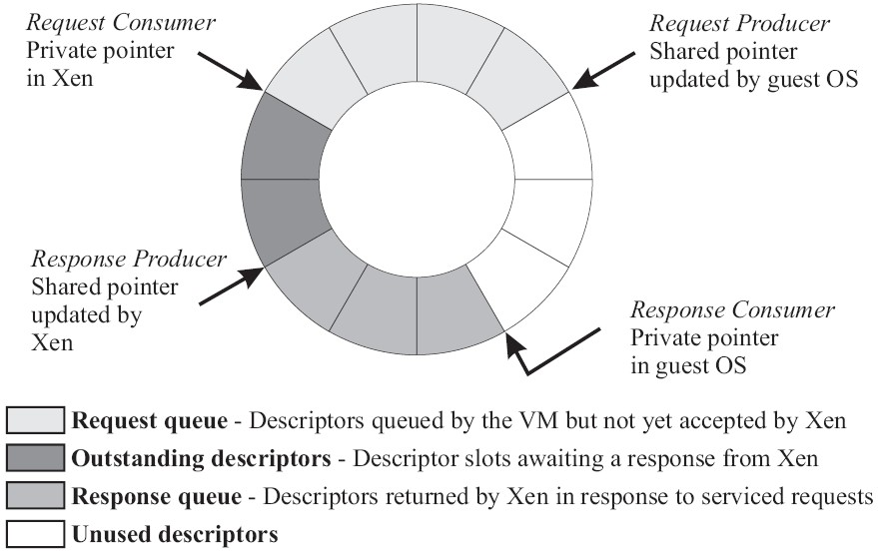
Details: I/O 2
I/O Descriptor Ring:

Slide 48
Data Transfer: Descriptor Ring
Descriptors are allocated by a domain (guest) and accessible from Xen
Descriptors do not contain I/O data; instead, point to data buffers also allocated by domain (guest)
Facilitate zero-copy transfers of I/O data into a domain

Slide 49
OS Porting Cost
Number of lines of code modified or added compared with original x86 code base (excluding device drivers)
Linux: 2995 (1.36%)
Windows XP: 4620 (0.04%)
Re-writing of privileged routines;
Removing low-level system initialization code

Slide 50
Control Transfer
Guest synchronously calls into VMM
Explicit control transfer from guest O/S to VM monitor/hypervisor, similar to system calls
“hypercalls”
VMM delivers notifications to guest O/S
E.g. data from network or when an I/O device is ready
Asynchronous event mechanism; guest O/S does not see hardware interrupts, only Xen notifications

Slide 51
Event notification
Pending events stored in per-domain bitmask
E.g. incoming network packet received
Updated by Xen before invoking guest OS handler
Xen-readable flag may be set by a domain
To defer handling, based on time or number of pending requests
Analogous to interrupt disabling

Slide 52
Network Virtualization
Each domain has 1+ network interfaces: virtual interfaces (VIFs)
Each VIF has 2 I/O rings (send, receive)
Each direction also has rules of the form (<pattern>,<action>) that are inserted by domain 0 (management)
Xen’s role: models/acts as a virtual firewall + router (VFR) to which all domain VIFs connect

Slide 53
Network Virtualization
Packet transmission:
Guest adds request to I/O ring
Xen copies packet header, applies matching filter rules
E.g. change header - IP source address for NAT
No change to payload; pages with payload must be pinned to physical memory until DMA to physical NIC for transmission is complete
Round-robin packet scheduler

Slide 54
Network Virtualization
Packet reception:
Xen applies pattern-matching rules to determine destination VIF
Guest O/S required to exchange unused page frame for each packet received
Xen exchanges packet buffer for page frame in VIF’s receive ring
If no receive frame is available, the packet is dropped
Avoids Xen-to-guest copies; requires page aligned receive buffers to be queued at VIF’s receive ring

Slide 55
Disk virtualization
Domain0 has access to physical disks
Currently: SCSI and IDE
All other domains: virtual block device (VBD)
Created & configured by management software at domain0
Accessed via I/O ring mechanism
Possible reordering by Xen based on knowledge about disk layout

Slide 56
Disk virtualization
Xen maintains translation tables for each virtual block device (VBD)
Used to map requests for VBD (ID,offset) to corresponding physical device and sector address
Zero-copy data transfers take place using DMA between memory pages pinned by requesting domain
Scheduling: batches of requests in round-robin fashion across domains

Slide 57
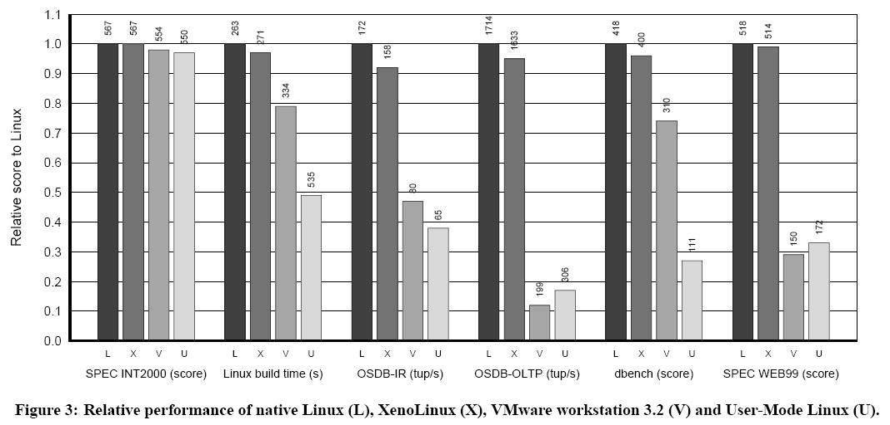
Evaluation

Slide 58
Microbenchmarks
Stat, open, close, fork, exec, etc
Xen shows overheads of up to 2x with respect to native Linux
(context switch across 16 processes; mmap latency)
VMware shows up to 20x overheads
(context switch; mmap latencies)
User Mode Linux shows up to 200x overheads
Fork, exec, mmap; better than VMware in context switches

Slide 59
CPU Virtualization with VT-x

Slide 60
VT-x : Motivation
To solve the problem that the x86 architecture instructions cannot be virtualized.
Simplify VMM software by closing virtualization holes by design.
Ring Compression
Non-trapping instructions
Excessive trapping
Eliminate need for software virtualization (i.e., paravirtualization, binary translation).

Slide 61
VMX
Virtual Machine Extensions define processor-level support for virtual machines on the x86 platform by a new form of operation called VMX operation.
Kinds of VMX operation:
root: VMM (hypervisor) runs in VMX root operation
non-root: Guest runs in VMX non-root operation
Eliminate de-privileging of Ring 0 for guest OS.

Slide 62
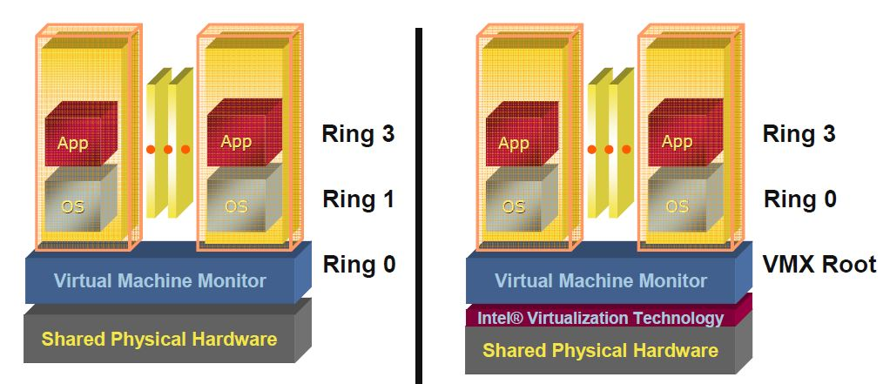
Pre VT-x Post without VT-x with VT-x
VMM ring de-privileging of guest OS | VMM executes in VMX root-mode
Guest OS aware its not at Ring 0 | Guest OS de-privileging eliminated
 | Guest OS views as if it “runs directly on hardware”

Slide 63
VMX Transitions
Transitions between VMX root operation and VMX non-root operation.
Kinds of VMX transitions:
VM Entry: Transitions into VMX non-root operation. Allows Guest OS to execute Priv. instructions as if it is in Ring 0
VM Exit: Transitions from VMX non-root operation to VMX root operation.
Registers and address space swapped in one atomic operation.

Slide 64
VMX Transitions
_{VM 1}
_{VM 2}
_{VM n}
VMX Non-Root Operation: Guest OS has access to priv. instructions
_{Ring 3}
_{Ring 3}
_{Ring 3}
App
_{Ring 0}
_{Ring 0}
_{Ring 0}
OS
_{VM Entry}
_{VMCS 1}
_{VMCS 2}
_{VMCS n}
_{VM Exit}
VMX Root Operation (hypervisor has access to priv. instr.)
_{Ring 3}
_{Ring 0}
_{vmlaunch / vmresume}
VMCS: VM Control Structure

Slide 65
VMCS: VM Control Structure
Data structure to manage VMX non-root operation and VMX transitions.
Specifies guest OS state.
Configured by VMM.
Controls when VM exits occur.
On VM entry, execution mode (guest state), dedicated to virtual instances allows Guest OS to execute privileged instructions without trapping to hypervisor
Defined by VM-execution control fields that control processor operation in VMX non-root operation

Slide 66
VMCS: VM Control Structure
The VMCS consists of six logical groups:
Guest-state area: Processor state loaded on VM entries from guest-state area; saved into guest-state area on VM exits.
Host-state area: Processor state loaded from the host-state area on VM exits.
VM-execution control fields: Fields controlling processor operation in VMX non-root operation.
VM-exit control fields: Fields that control VM exits.
VM-entry control fields: Fields that control VM entries.
VM-exit information fields: Read-only fields to receive information on VM exits describing the cause and the nature of the VM exit.

Slide 67
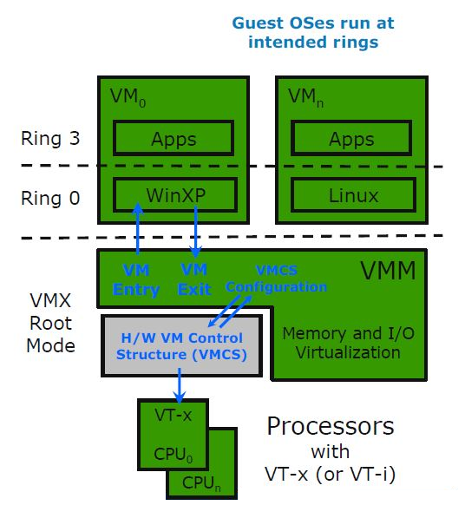
CPU Virtualization with VT-x
_{Source: [2]}

Slide 68
MMU Virtualization with VT-x

Slide 69
VPID: Motivation
First generation VT-x forces TLB flush on each VMX transition.
Performance loss on all VM exits.
Performance loss on most VM entries
Guest page tables not modified always
Better VMM software control of TLB flushes is beneficial.
A translation lookaside buffer is part of the chip's memory-management unit: TLB contains page table entries that have been most recently used.

Slide 70
VPID: Virtual Processor Identifier
16-bit virtual-processor-ID field in the VMCS.
Cached linear translations tagged with VPID value.
No flush of TLBs on VM entry or VM exit if VPID active.
TLB entries of different virtual machines can all co-exist in the TLB.

Slide 71
Virtualizing Memory in Software
Three abstractions of memory:
₀
_{4GB}
_{Current Guest Process}
_{Guest OS}
_{Virtual}
_{Address Spaces}
₀
_{4GB}
_{Virtual RAM}
_{Virtual}
_{Frame}
_{Buffer}
_{Virtual}
_{Devices}
_{Virtual}
_{ROM}
_{Physical}
_{Address Spaces}
₀
_{4GB}
_{RAM}
_{Devices}
_{Frame}
_{Buffer}
_{ROM}
_{Machine}
_{Address Space}

Slide 72
Shadow Page Tables
VMM maintains shadow page tables that map guest-virtual pages directly to machine pages.
Guest modifications to V->P tables synced to VMM V->M shadow page tables.
Guest OS page tables marked as read-only.
Modifications of page tables by guest OS -> trapped to VMM.
Shadow page tables synced to the guest OS tables

Slide 73
Drawbacks: Shadow Page Tables
Under shadow paging, in order to provide transparent MMU virtualization, the VMM intercepts guest page table updates to keep the shadow page tables coherent with the guest page tables.
Maintaining consistency between guest page tables and shadow page tables leads to overhead: VMM traps
Loss of performance due to TLB flush on every “world-switch”.
Memory overhead due to shadow copying of guest page tables.

Slide 74
Set CPU Rings CR3 by guest OS (1)
_{Guest}
_{Page Table}
_{Guest}
_{Page Table}
_{Guest}
_{Page Table}
_{Virtual CR3}
_{Real CR3}
_{Shadow}
_{Page Table}
_{Shadow}
_{Page Table}
_{Shadow}
_{Page Table}
_{Source: [6]}

Slide 75
Set CPU Rings CR3 by guest OS (2)
_{Guest}
_{Page Table}
_{Guest}
_{Page Table}
_{Guest}
_{Page Table}
_{Virtual CR3}
_{Real CR3}
_{Shadow}
_{Page Table}
_{Shadow}
_{Page Table}
_{Shadow}
_{Page Table}

Slide 76
Nested / Extended Page Tables
With the introduction of EPT, the VMM can now rely on hardware to eliminate the need for shadow page tables. This removes much of the overhead incurred to keep the shadow page tables up-to-date.
Extended page-table mechanism (EPT) is used to support the virtualization of physical memory.
Translates the guest-physical addresses used in VMX non-root operation.
Guest-physical addresses are translated by traversing a set of EPT paging structures to produce physical addresses that are used to access memory.
REF: https://www.vmware.com/pdf/Perf_ESX_Intel-EPT-eval.pdf

Slide 77
Use of EPT
guest operating system continues to maintain LPN->PPN mappings in the guest page tables, but
VMM maintains PPN->MPN mappings in an additional level of page tables, called nested page tables.
Both guest page tables and the nested page tables are exposed to hardware.
When logical address accessed, hardware walks guest page tables like native execution
for every PPN accessed during the guest page table walk, hardware also walks nested page tables to determine corresponding MPN.
composite translation eliminates need to maintain shadow page tables and synchronize them with guest page tables

Slide 78
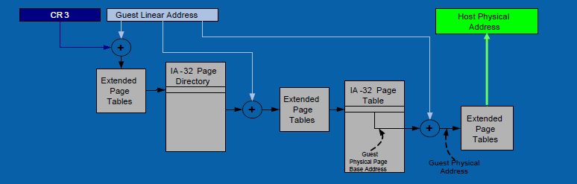
Nested / Extended Page Tables

Slide 79
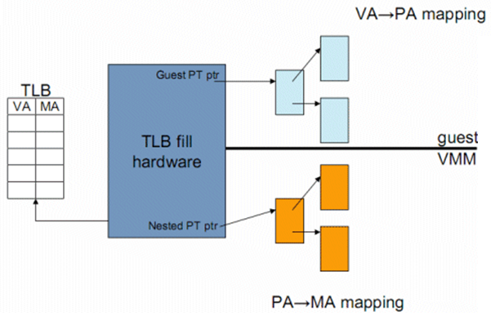
Nested / Extended Page Tables
_{Source: [4]}

Slide 80
Advantages: EPT
Simplified VMM design.
Guest page table modifications need not be trapped, hence VM exits reduced.
Reduced memory footprint compared to shadow page table algorithms.

Slide 81
Disadvantages: EPT
TLB miss is very costly since guest-physical address to machine address needs an extra EPT walk for each stage of guest-virtual address translation.

Slide 82
Virtual Appliances & Multi-Core
Virtual appliance: pre-configured VM with OS/ apps pre-installed
Just download and run (no need to install/configure)
Software distribution using appliances
(see: “SnowFlock: Rapid Virtual Machine Cloning for Cloud Computing”, H. Andrés Lagar-Cavilla et. al., Eurosys 2009)
Multi-core CPUs
Run multiple VMs on multi-core systems
Each VM assigned one or more vCPU
Mapping from vCPUs to physical CPUs
Today: Virtual appliances have evolved into Docker containers

Slide 83
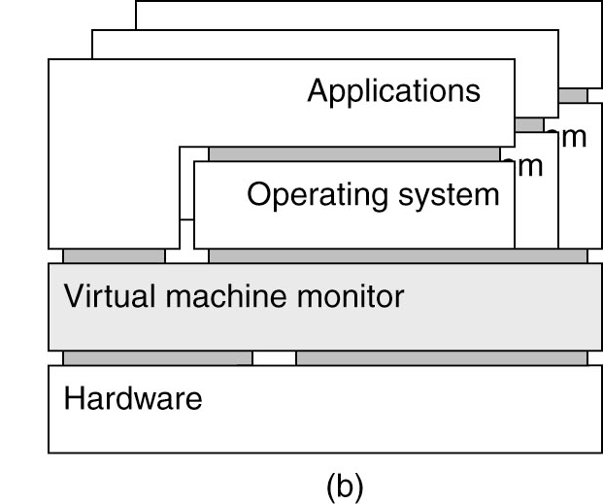
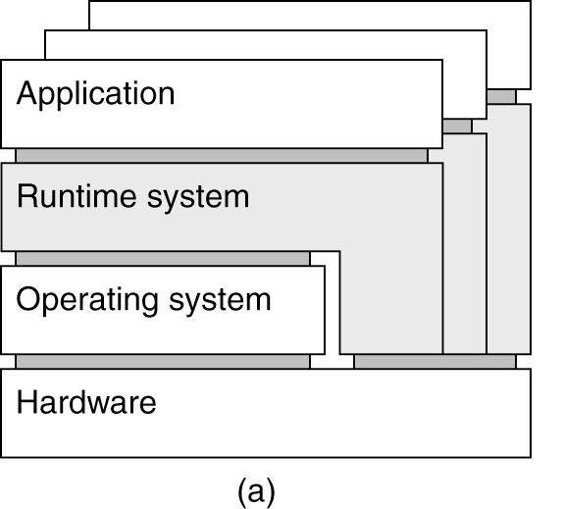
Examples
Application-level virtualization: “process virtual machine”
VMM /hypervisor

Slide 84
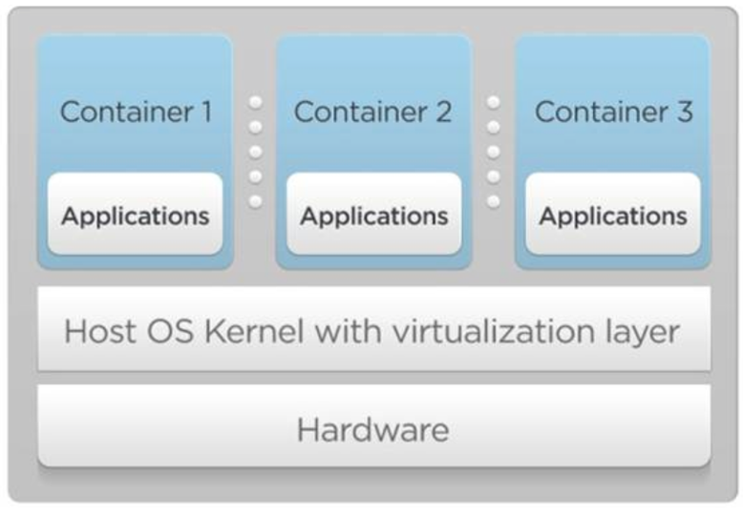
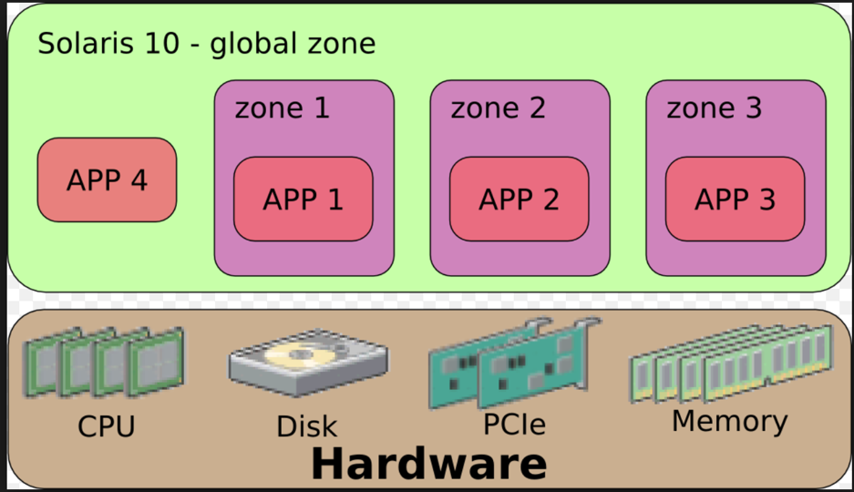
OS Virtualization
Emulate OS-level interface with native interface
“Lightweight” virtual machines
No hypervisor, OS provides necessary support
Referred to as containers
Solaris containers, BSD jails, Linux containers

Slide 85
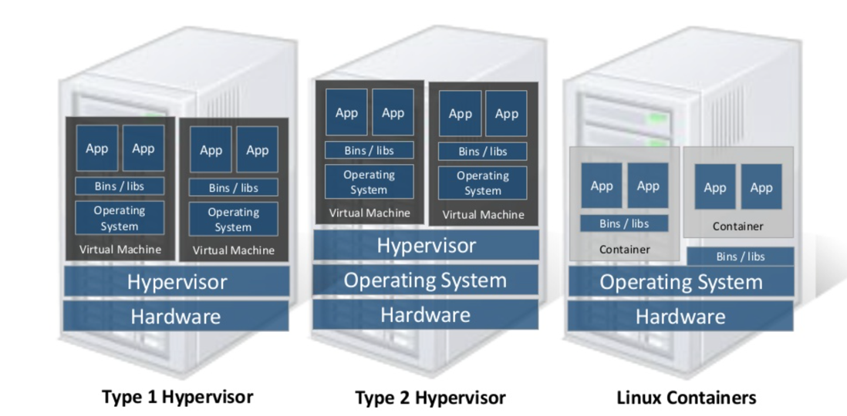
Linux Containers (LXC)
Containers share OS kernel of the host
OS provides resource isolation
Benefits
Fast provisioning, bare-metal like performance, lightweight
Material courtesy of “Realizing Linux Containers” by Boden Russell, IBM

Slide 86
OS Mechanisms for LXC
OS mechanisms for resource isolation and management
namespaces: process-based resource isolation
Cgroups: limits, prioritization, accounting, control
chroot: change the apparent root directory for the current running process and its children.
Program run in such modified environment cannot name files outside designated directory tree.
Linux security module, access control
Tools (e.g., docker) for easy management

Slide 87
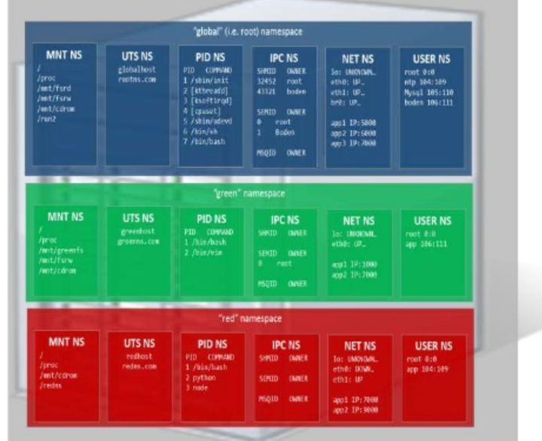
Linux Namespaces
Namespace: restrict what a container can see
Provide process level isolation of global resources
Processes have illusion they are the only processes in the system
MNT: mount points, file systems (what files, dir are visible)?
PID: what other processes are visible?
NET: NICs, routing
Users: what uid, gid are visible?
chroot: change root directory

Slide 88
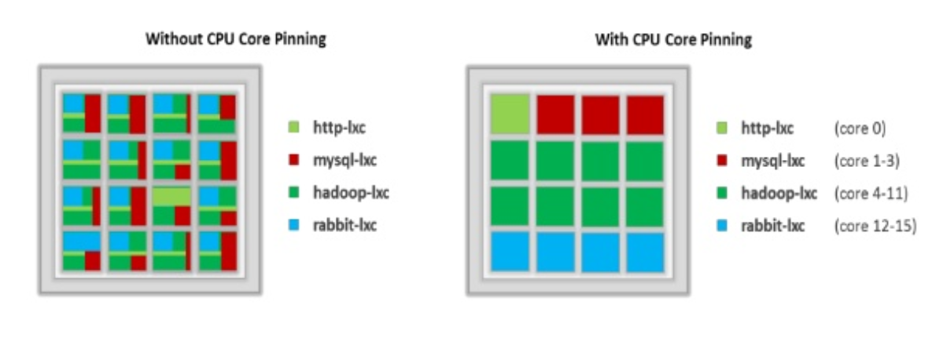
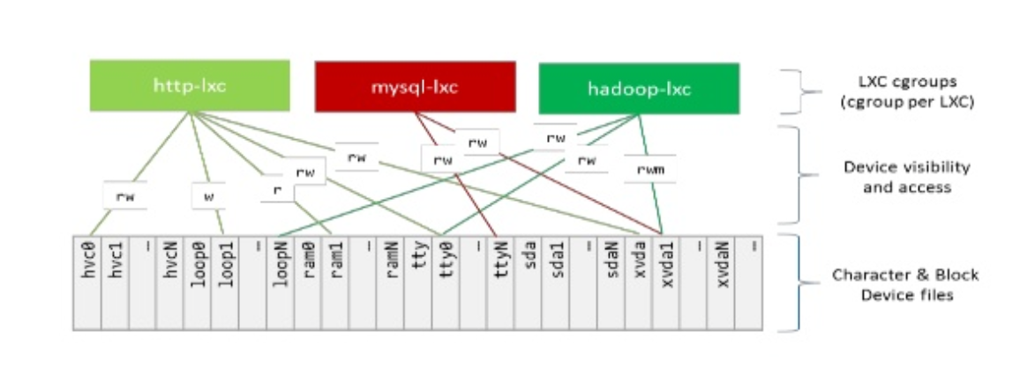
Linux cgroups
Resource isolation
what and how much can a container use?
Set upper bounds (limits) on resources that can be used
Fair sharing of certain resources
Examples:
cpu: weighted proportional share of CPU for a group
cpuset: cores that a group can access
block io: weighted proportional block IO access
memory: max memory limit for a group

Slide 89
Proportional Share Scheduling
Resource allocation
Uses a variant of proportional-share scheduling
Share-based scheduling:
Assign each process a weight w_i (a “share”)
E.g., CPU Allocation is in proportion to the ‘share'
fairness: reused unused cycles to others in proportion to weight
Examples: fair queuing, start time fair queuing
Hard limits: assign upper bounds (e.g., 30%), no reallocation
Credit-based: allocate credits every time T, can accumulate credits, and can burst up-to credit limit
can a process starve other processes?

Slide 90
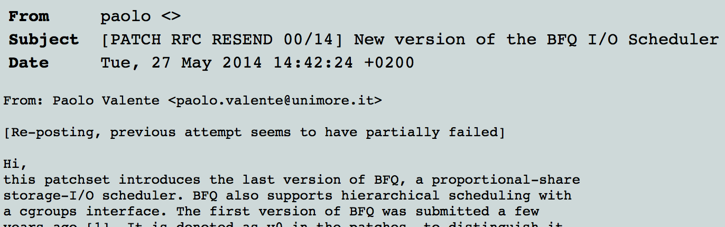
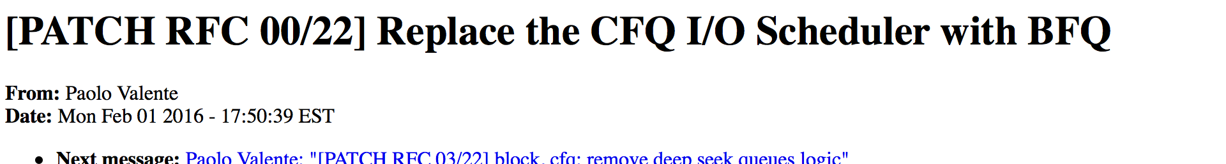
Share-based Schedulers

Slide 91
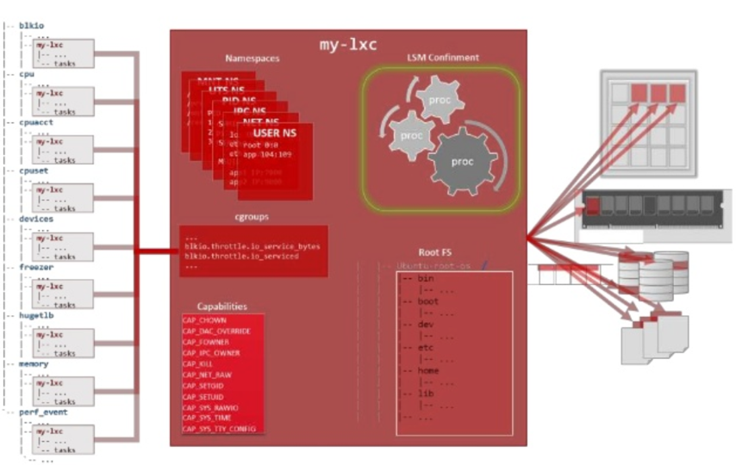
Putting it all together
Images: files/data for a container
can run different distributions/apps on a host
Linux security modules and access control
Linux capabilities: per process privileges

Slide 92
Docker and Linux Containers
Linux containers are a set of kernel features
Need user space tools to manage containers
Virtuoze, OpenVZm, VServer, Lxc-tools, Wardenm Docker
What does Docker add to Linux containers?
Portable container deployment across machines
Application-centric: geared for app deployment
Automatic builds: create containers from build files
Component re-use
Docker containers are self-contained: no dependencies

Slide 93
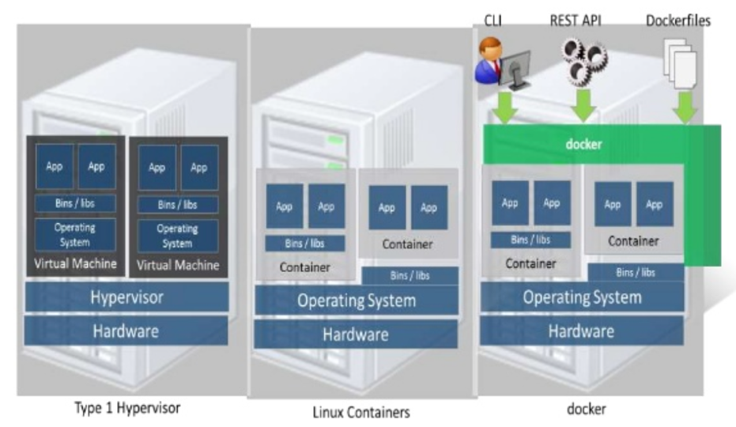
Docker
Docker uses Linux containers

Slide 94
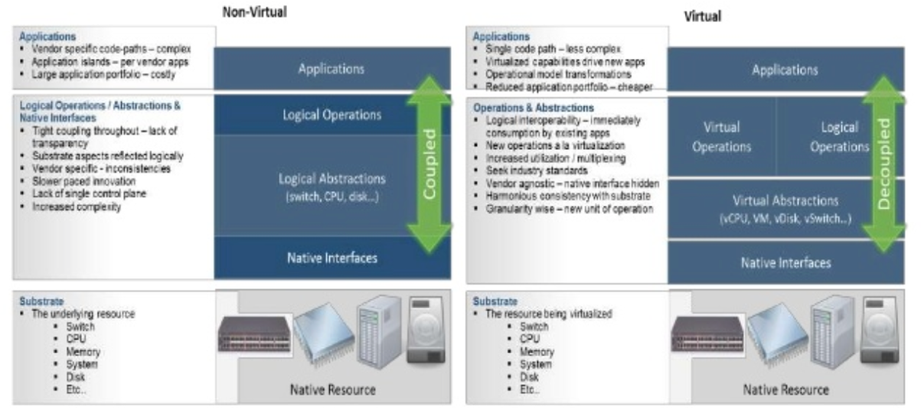
LXC Virtualization Using Docker
Portable: docker images run anywhere Docker runs
Docker decouples LXC provider from operations
uses virtual resources (LXC virtualization)
fair share of physical NIC vs use virtual NICs that are fair-shared

Slide 95
Docker Images and Use
Docker uses a union file system (AuFS)
allows containers to use host FS safely
Essentially a copy-on-write file system
read-only files shared (e.g., share glibc)
make a copy upon write
Allows for small efficient container images
Docker Use Cases
“Run once, deploy anywhere”
Images can be pulled/pushed to repository
Containers can be a single process (useful for microservices) or a full OS

Slide 96
Use of Virtualization Today
Data centers:
server consolidation: pack multiple virtual servers onto a smaller number of physical servers
saves hardware costs, power and cooling costs
Cloud computing: rent virtual servers
cloud provider controls physical machines and mapping of virtual servers to physical hosts
User gets root access on virtual server
Desktop computing:
Multi-platform software development
Testing machines
Run apps from another platform

Slide 97
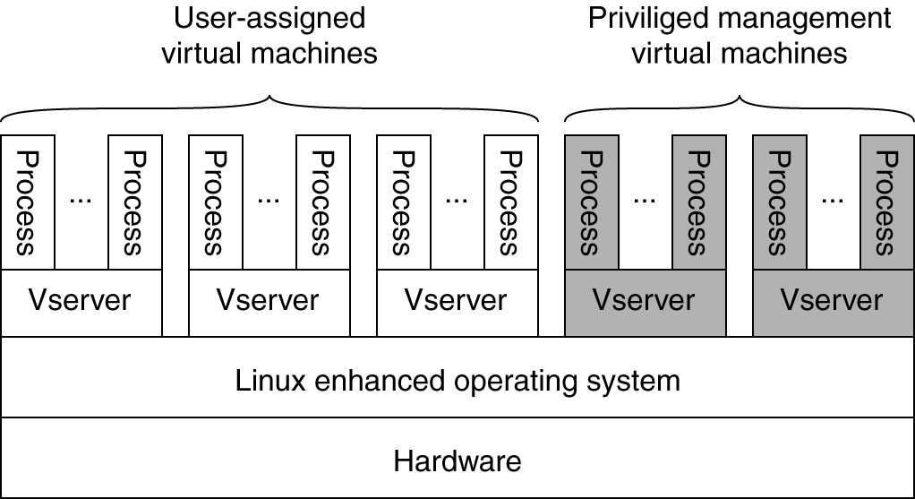
Case Study: PlanetLab
Distributed cluster across universities
Used for experimental research by students and faculty in networking and distributed systems
Uses a virtualized architecture
Linux Vservers
Node manager per machine
Obtain a “slice” for an experiment: slice creation service

